Slide 1

On Road Wireless Charging System
Members: 1) Gourav Suryakant Jalan 20UET038
2) Manoj Mahesh Kumbhar 20UET065
3) Avinash Jagannath Masal 20UET080
Guide: Prof. V. B. Sutar

Slide 2
Introduction
The eco-friendly vehicle is the global trend in the automobile industry.
The electrical vehicle (EV) is the most suitable alternative of petroleum vehicles.
To design and develop an on road wireless charging system for the electric vehicles.
To solve these problems, wireless charging of electric vehicle is introduced.

Slide 3
Problem Statement
Addressing EV Charging Incompatibility due to Varied Charger Adapters Through the Implementation of On Road Wireless Charging System for Electric Vehicles. The On Road wireless Charging System should overcome the limitations of wired charging methods.

Slide 4
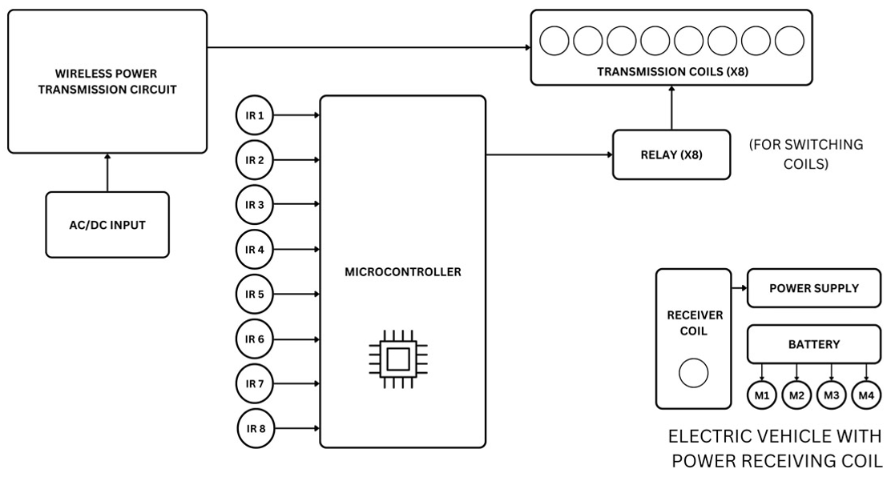
Block Diagram

Slide 5
Flowchart
Start
Laptop
Arduino
Multiple
Relays
Multiple IR Senors
Wireless Transfer System
Yes
Relay 1=HIGH
IR Sensor 1
Yes
Coil
No
IR Sensor 2 1
Relay 2=
HIGH
No
Yes
Relay n
IR Sensor n n
Fig.3

Slide 6
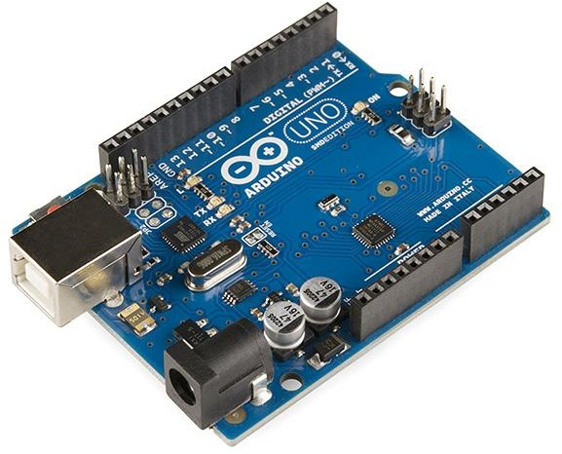
Components :
ARDUINO BOARD:-

Slide 7
The Arduino is open source microcontroller board based on Michrochip ATmega328P microcontroller and developed by Arduino.c.
The board is equipped with sets of digital and analog input/output (I/O) pins that may be interfaced to various expansion boards (shields) and other circuits.
The board has 14 digital I/O pins (six capable of PWM output), 6 analog I/O pins, and is programmable with the Arduino IDE (Integrated Development Environment), via a type B USB cable.
It can be powered by the USB cable or by an external 9-volt battery, though it accepts voltages between 7 and 20 volts.

Slide 8
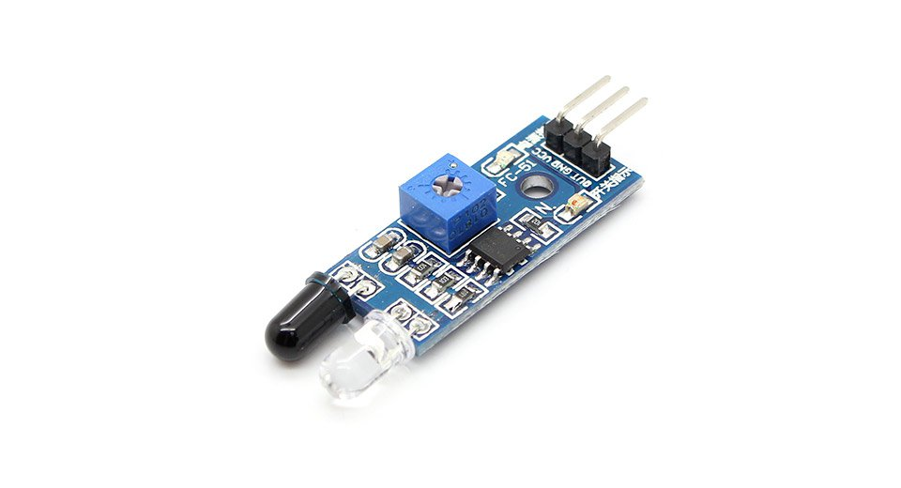
IR SENSOR:-
An infrared (IR) sensor is an electronic device that measures and detects infrared radiation in its surrounding environment.
IR is invisible to the human eye, as its wavelength is longer than that of visible light .
Anything that emits heat (everything that has a temperature above around five degrees Kelvin) gives off infrared radiation.
There are two types of infrared sensors : Active and Passive IR Sensors.

Slide 9
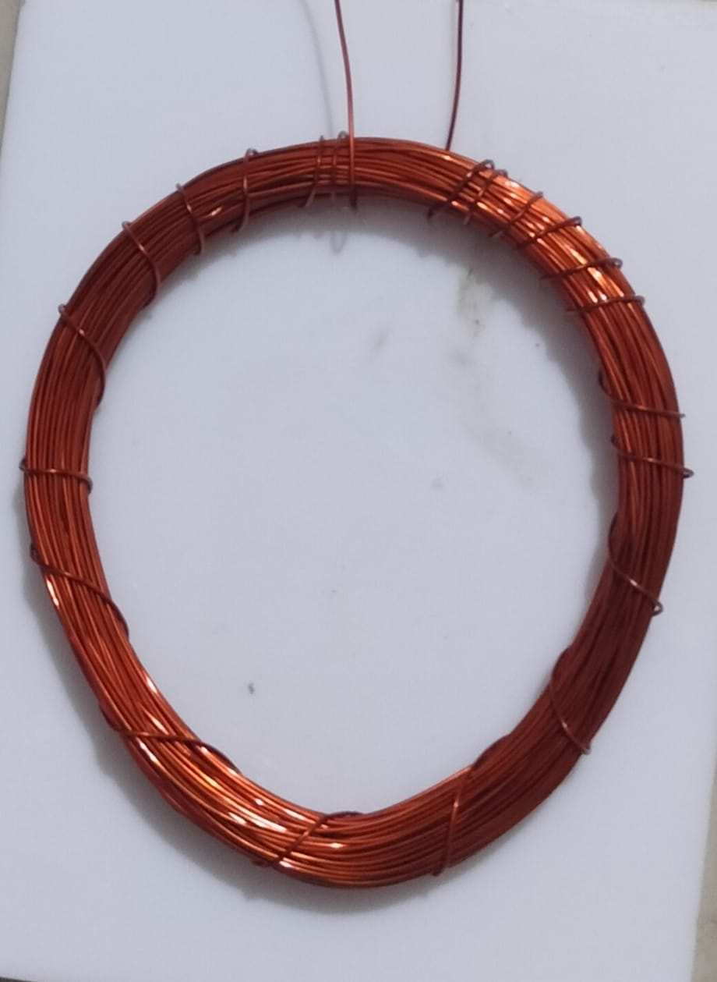
Copper Coil :

Slide 10
Tesla coils are electrical resonant transformers invented by Nikola Tesla in the late 19th century. The primary design typically involves two main components: a primary coil and a secondary coil.
The primary coil is connected to a high-voltage power source and oscillates at a specific frequency, creating an oscillating magnetic field. This field induces a high voltage in the secondary coil, which can produce spectacular electrical discharges.
The primary coil is often made of thick copper wire, capable of handling high currents without significant resistance.
The secondary coil, wound around a cylindrical form, also utilizes copper wire, typically thinner and more tightly wound to create a higher voltage output.

Slide 11
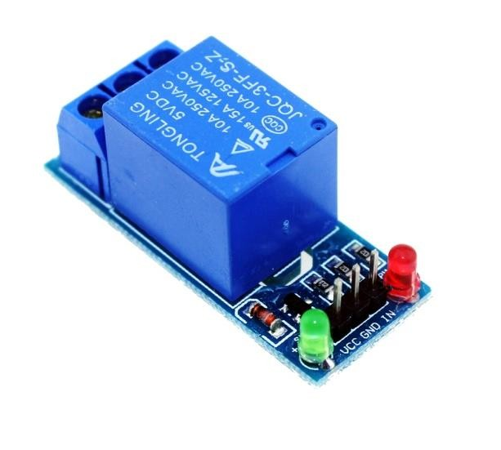
Relay :-

Slide 12
Relays are simple switches which are operated both electrically and mechanically.
Relays consist of an electromagnet and also a set of contacts.
The main operation of a relay comes in places where only a low-power signal can be used to control a circuit.
It is also used in places where only one signal can be used to control a lot of circuits. They were used to switch the signal coming from one source to another destination.
The high end applications of relays require high power to be driven by electric motors and so on. Such relays are called contactors.

Slide 13
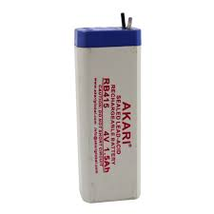
Battery :-

Slide 14
Lead-acid batteries are a type of rechargeable battery commonly used in vehicles, uninterruptible power supplies (UPS), and various industrial applications.
They consist of lead dioxide (positive plate), sponge lead (negative plate), and sulfuric acid electrolyte.
During discharge, lead sulfate forms on the plates; during charging, it converts back to lead dioxide and sponge lead.
Lead-acid batteries are known for their reliability, low cost, and ability to deliver high surge currents.
However, they are heavy, have a low energy-to-weight ratio, and require regular maintenance.

Slide 15
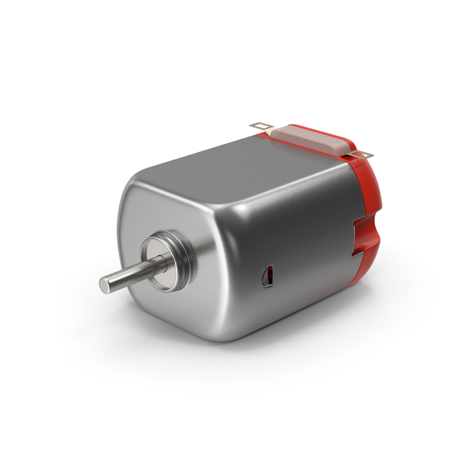
Motor :-
Toy motors are small electric motors commonly used in various toys and hobby projects. They come in different sizes and specifications,
DC toy motors operate based on the principles of electromagnetism.
These motors are often used in simple toys like model cars, boats, or small robots.

Slide 16
Advantages of Wireless Charging :
Secure method of charging your device.
Reduces the complexity of cords and adapters.
Minimizes the chance of electrical and device failures.
Reduces the devices’ overheating problem.
Noise Pollution will also be reduced.
No use of fuels like Petrol, Diesel, CNG etc.

Slide 17
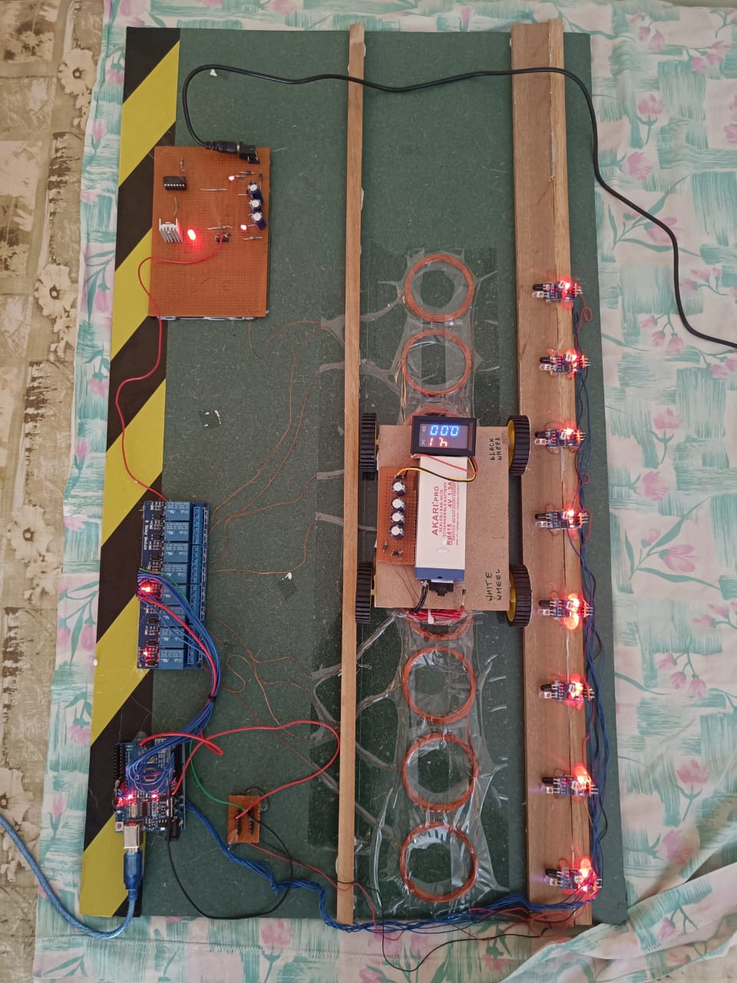
Result

Slide 19
Coil | Reading
Coil 1 | 3.90
Coil 2 | 3.4
Coil 3 | 3.6
Coil 4 | 4.0
Coil 5 | 4.0
Coil 6 | 3.8
Coil 7 | 3.98
Coil 8 | 3.99

Slide 20
References
L. Hua, J. Wang and C. Zhou, “Adaptive electric vehicle charging coordination on distribution network,” IEEE Transactions on Smart Grid. IEEE, vol.5, pp. 2666- 2675, 2014.
Singh, sagolsem & hasarmani, totappa & holmukhe, rajesh. (2012). Wireless transmission of electrical power overview of recent research & development. International journal of computer and electrical engineering. 207-211. 10.7763/ijcee.2012.v4.480.
N. Xu and Y .Chung, “Reliability evaluation of distribution systems including vehicle-to- home and vehicle-to-grid,” IEEE Transactions on Power Systems. IEEE, vol. 31, pp.759-768, 2016.

Slide 21
Thank you!

